Slide 1

Docker & Kubernetes Security 101
By Antonio Juanilla(Specter)

Slide 2

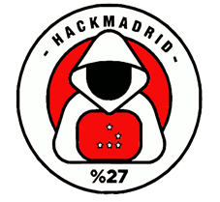
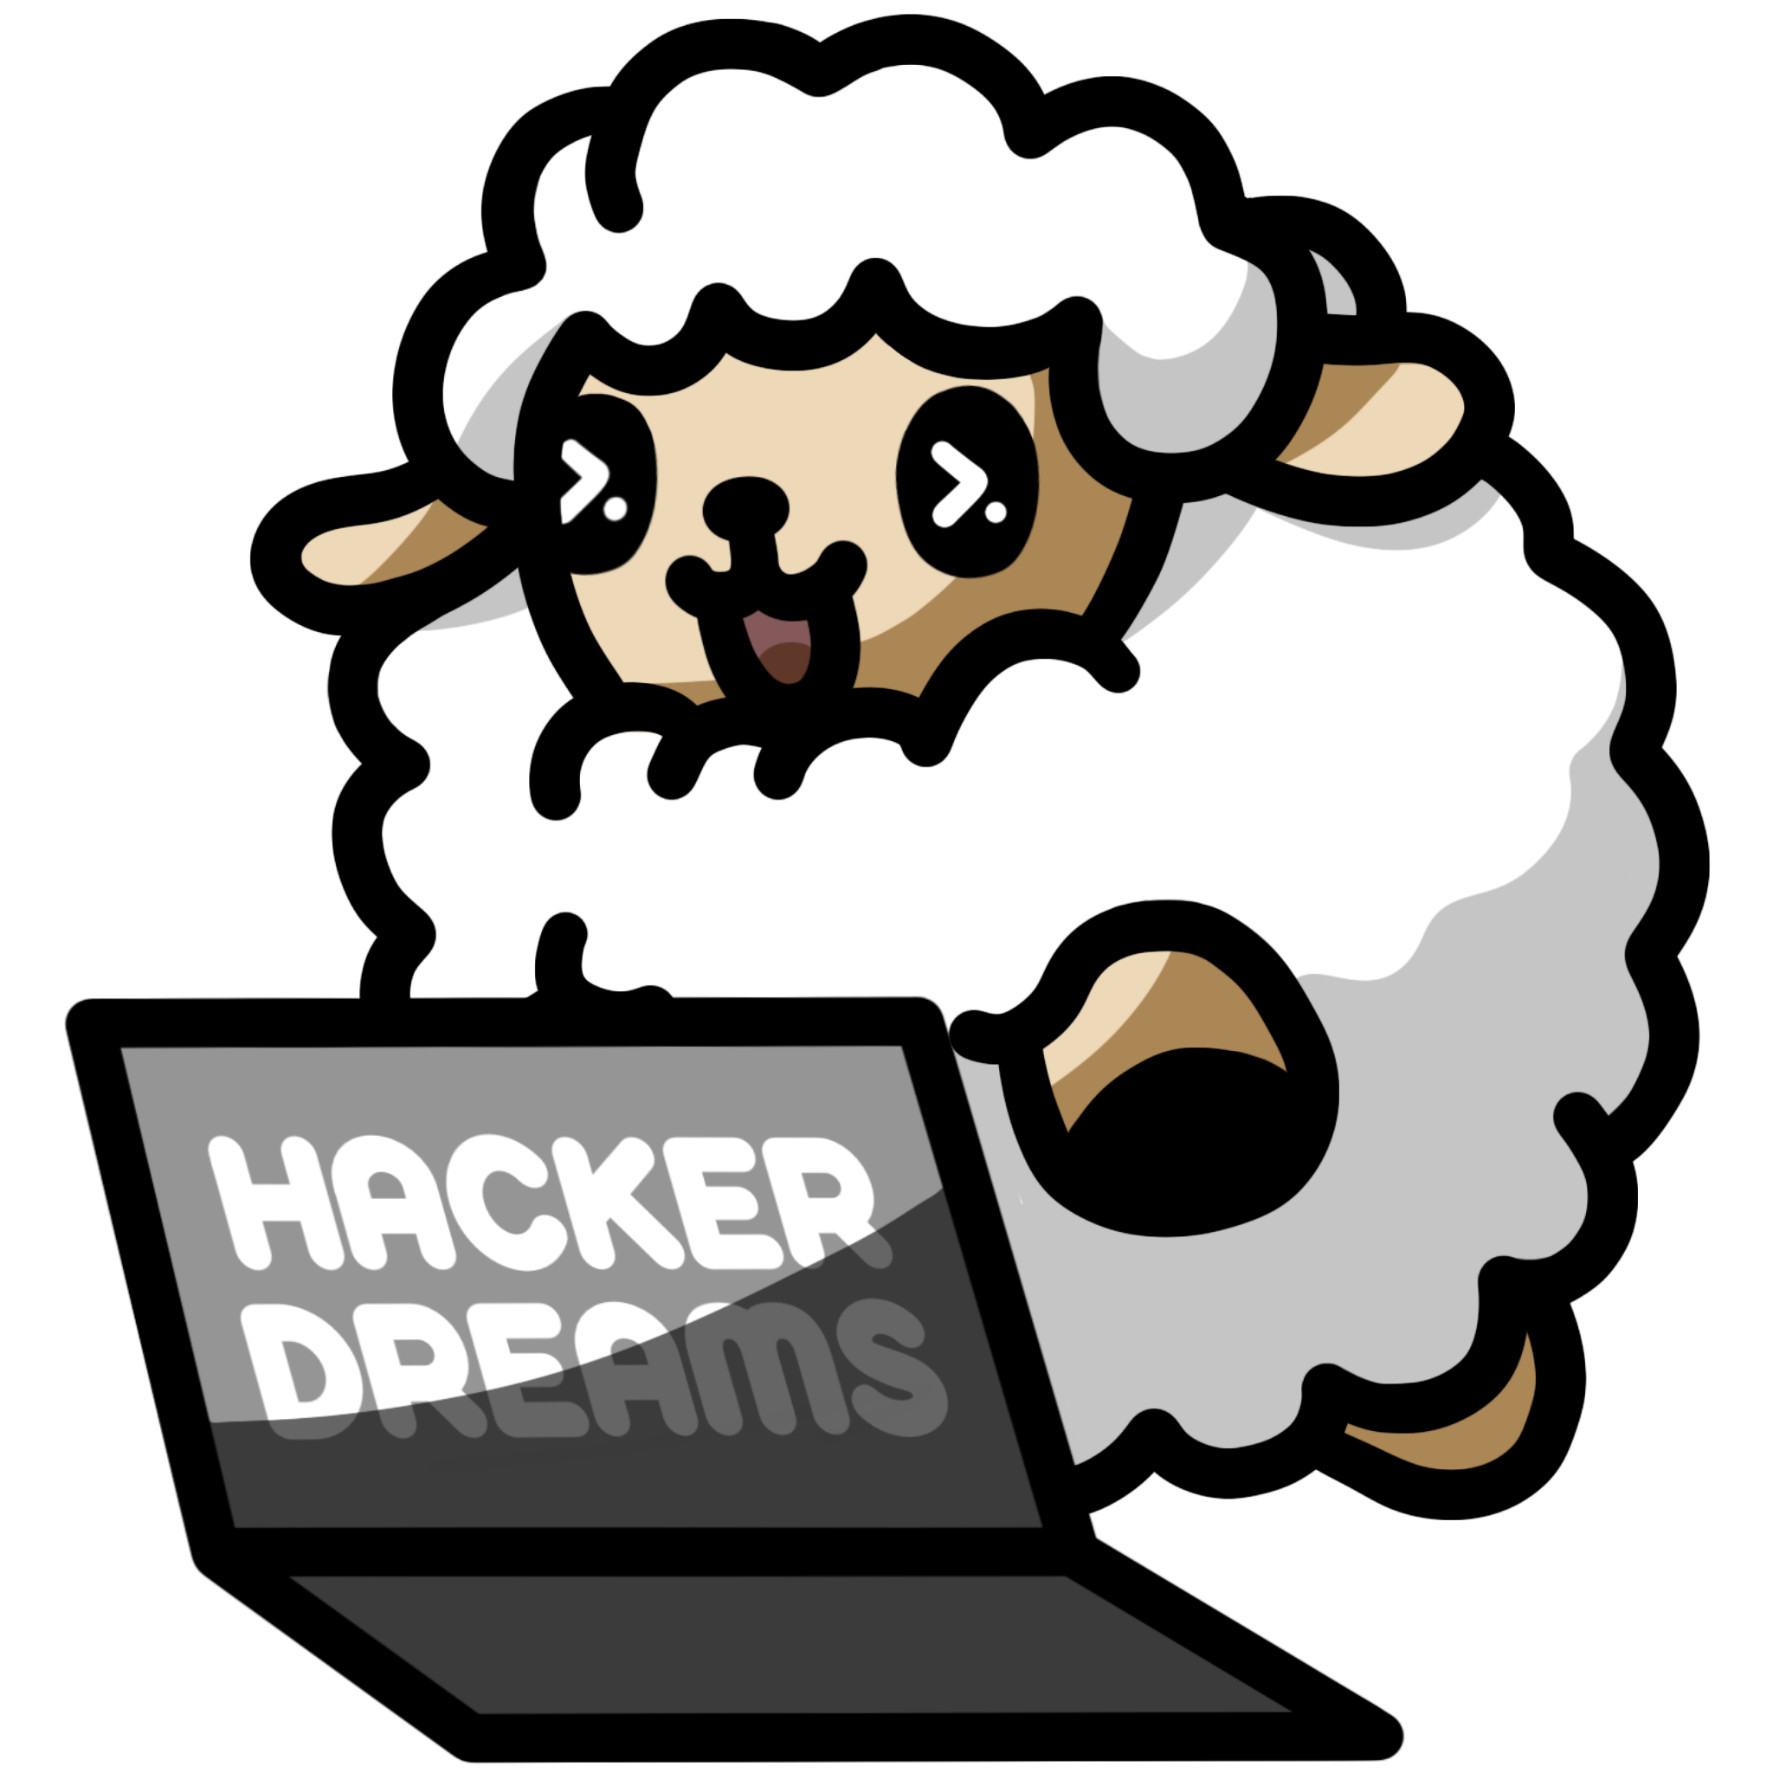
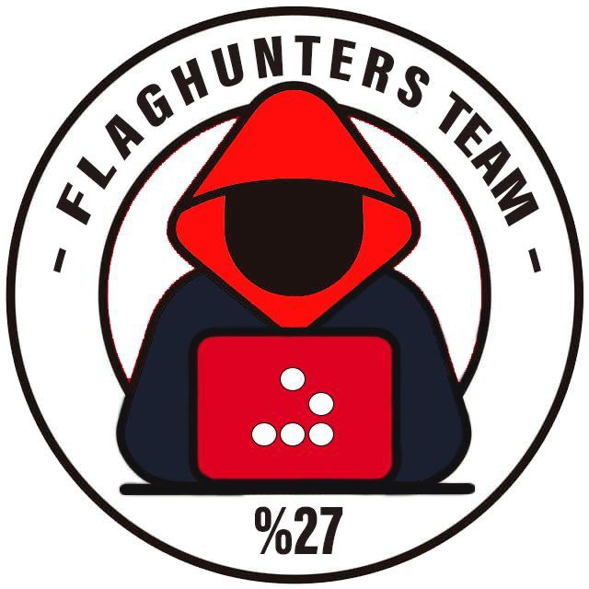

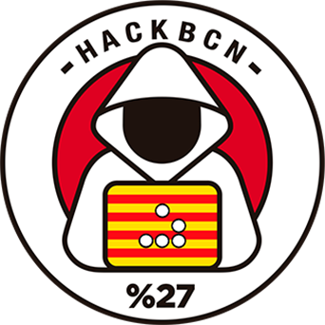

$Whoami
Antonio Juanilla
Self-taught.
DevSecOps(SecDevOps).
Co organizer in many comunities %27.
DevSecCon Chapter Leader
International Speaker.
Leader in CTF Team flagHunters.
Tech Lover.
Twitter: @spectertj
Linkendin: https://www.linkedin.com/in/spectertj
Github: spectertj
Instagram: spectertj

Slide 3

Secure development
Validate input data.
Validate output data.
Validate DB calls.
Scan source code to find vulns
Test.

Slide 4
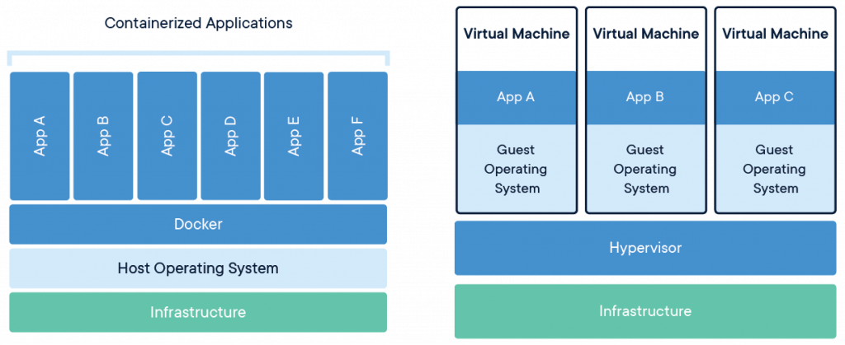

Slide 5
Container benefits
Multi platform in cloud
Share same OS.
Speed
Efficiency cost
Portability
CI-CD

Slide 6
Misuse of containers
Lack of security
Lack of isolation
Monitorization by themself

Slide 7
Attack surface
OS and kernel attacks.
Network-based attacks.
Daemon-based attacks.
Image-based attacks.
Application-based attacks.

Slide 8

Securing Dockers

Slide 9
Security recommendations
Securing host.
Reverse proxys.
Load balancers.
Use SSL/TLS.
Force Https.
DoS attacks preventing tools.
Use WAF (Web Applications Firewall).
Use Dockrfiles.
Verify public Docker images.

Slide 10
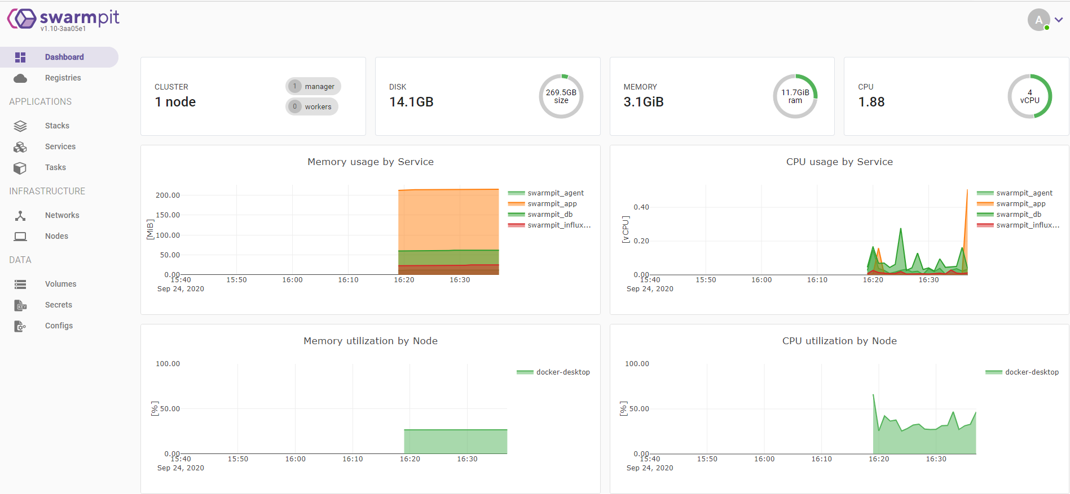

Slide 11
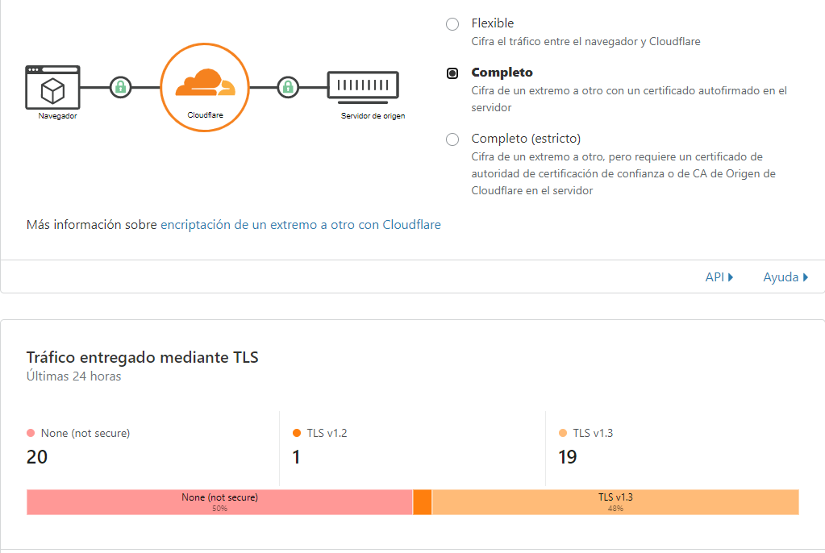

Slide 12
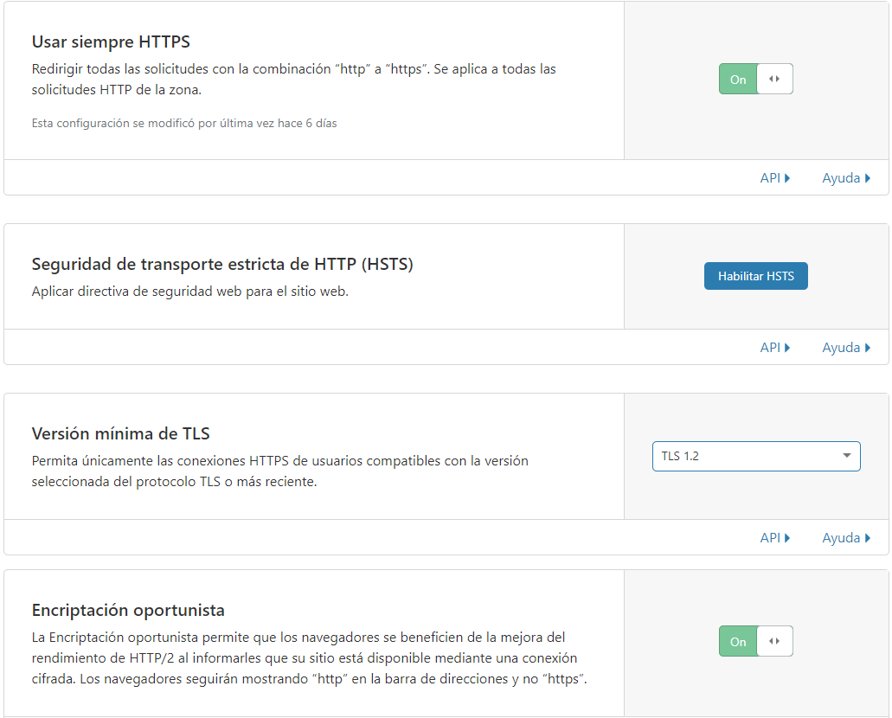

Slide 13
Tools
https://www.ssllabs.com/ssltest/
https://mozilla.github.io/server-side-tls/ssl-config-generator/
https://www.cisecurity.org/cis-benchmarks/
https://www.cisecurity.org/benchmark/docker/
https://www.owasp.org/index.php/OWASP_WAP-Web_Application_Protection
https://github.com/red-panda-ci/red-panda-ci-symfony
https://github.com/red-panda-ci/red-panda-ci-symfony/tree/master/ci-scripts/test/cucumber
https://www.cloudflare.com
https://hub.docker.com/r/chef/inspec/

Slide 14
Container Security 101
1. Prefer minimal base images:-
The Docker images that are used have as many as 580 vulnerabilities in their system libraries
Choose images with fewer OS libraries and tools lower the risk and attack surface of the container
Prefer alpine-based images over full-blown system OS images
2. Least privileged user:-
Create a dedicated user and group on the image, with minimal permissions to run the application; use the same user to run this process.
3. Sign and verify images to mitigate:-
It is critical to make sure the image we’re pulling is the one pushed by the publisher, and that no one has tampered with it.
Verify the trust and authenticity of the images you pull
Sign your images with the help of Notar

Slide 15
Container Security 101
4. Find, fix and monitor for open source vulnerabilities
Scan your Docker images for known vulnerabilities and integrate them as part of your continuous integration. Use commands that are mentioned below to scan and get detailed reports from
How to scan images:- $ docker scan hello-world
Get a detailed scan report:- $ docker scan — file Dockerfile docker-scan:e2e
Excluding the base image:- $ docker scan — file Dockerfile — exclude-base docker-scan:e2e
Checking the dependency tree:- $ docker scan — dependency-tree debian:buster
Limiting the level of vulnerabilities displayed:- $ docker scan — severity=medium docker-scan:e2e
5. Don’t leak sensitive information to Docker images
It’s easy to accidentally leak secrets, tokens, and keys into images when building them. To stay safe, follow these guidelines:
Use multi-stage builds
Use the Docker secrets feature to mount sensitive files without caching them (supported only from Docker 18.04)
Use a .dockerignore file to avoid a hazardous COPY instruction, which pulls insensitive files that are part of the build context

Slide 16
Container Security 101
6. Use fixed tags for immutability
Docker image owners can push new versions to the same tags, which may result in inconsistent images during builds, and makes it hard to track if a vulnerability has been fixed. Prefer one of the following:
A verbose image tag with which to pin both version and operating system, for example: FROM node:8-alpine
An image hash to pin the exact contact, for example: FROM node:
7. Use COPY instead of ADD:-
Arbitrary URLs specified for ADD could result in MITM attacks or sources of malicious data. In addition, ADD implicitly unpacks local archives which may not be expected and result in path traversal and Zip Slip vulnerabilities.
Use COPY, unless ADD is specifically required.

Slide 17
Docker Security 101
8. Use metadata labels:-
Use and communicate a Responsible Security Disclosure policy by adopting a SECURITY.TXT policy file and providing this information in your images labels
9. Use a linter
Enforce Dockerfile best practices automatically by using a static code analysis tool such as hadolint linter, that will detect and alert for issues found in a Dockerfile.

Slide 18
But in Kubernetes?
Privilege and user management: Limit the privileges granted to pods. Do not grant them more access to system resources than necessary. Use specific service accounts and minimum permissions for pods, through ServiceAccounts and RBAC.
Secure container images: Scan and verify container images to be run on pods prior to deployment. Prevents execution of images with known vulnerabilities.
Network Policies: Implements Network Policies to control network traffic that is allowed or denied between pods. This helps prevent unauthorized communication. Considers the principle of least privilege when defining network policies.
Resources and limits: Sets resources and limits for pods, which prevents them from consuming all cluster resources and ensures fair performance. Uses the resource limitation policy to avoid exhausting CPU or memory on a single pod.
Secrets management: Never store secrets, such as passwords or API keys, directly in pod definitions. Employ Kubernetes Secrets or other secrets management solutions. Limit access to secrets to only those pods that really need them.
Run containers with the right user: Define the user and user group in the container configuration. Avoid running containers as the root user whenever possible. This limits the attack surface and reduces risks.
Auditing and logging: Configure Kubernetes auditing to track pod activities, allowing you to detect unusual or suspicious behavior. Use tools such as Falco or Sysdig to generate real-time alerts based on the audit log.
Updates and patches: Keep both pod operating systems and the applications running on them up to date. Apply security patches on a regular basis. Use tools such as OPA-Gatekeeper to enforce security policies, such as ensuring that only updated images are running.
Monitoring and alerts: Implement monitoring systems to oversee pod behavior and performance. Set up alerts to notify you of potential security issues, such as policy violations.

Slide 19
Kubernetes 101
Contianer SecurityContext :
runAsNonRoot: true: This ensures that the container is run with a user that is not the root user, which reduces security risks.
runAsUser: 1000: Specifies the user ID to be used when running the archive. You should assign a non-privileged user.
allowPrivilegeEscalation: false: Prevents the container process from escalating to higher privileges, which is important to prevent attacks.
readOnlyRootFilesystem: true: Makes the container's root filesystem read-only, reducing the attack surface.

Slide 20
Thx so much
and
Never forget DevSecOps
Twitter: @spectertj
Linkendin: https://www.linkedin.com/in/spectertj/
Github: spectertj
Instagram: spectertj
Meetup: https://www.meetup.com/devseccon-spain/
DevSecCon Discord: https://discord.gg/NXuz63GmUt

